Slide 1
KTB CREDIT CARD
SCORING PROGRAM
DOCUMENTATION
(SCORING)
Covers Version 1.53
September 25, 2006
Decision Analytics Consulting

Slide 2
CONTENTS
Technical highlights
Input and output environment
Application Programming Interface
Program flow
Program files

Slide 3
TECHNICAL HIGHLIGHTS
Windows-based DLL
Developed with Borland C++ Builder 6
Require Microsoft SQL server 2000 database to operate
Require the following eight Borland run-time library to operate:
  adortl60.bpl − borlandmm.dll − cc3260mt.dll
  dbrtl60.bpl − rtl60.bpl − stlpmt45.dll
  vcl60.bpl − vclx60.bpl
Connect to database via Microsoft ADO (Active Data Objects)

Slide 4
CONTENTS
Technical highlights
Input and output environment
Application Programming Interface
Program flow
Program files

Slide 5
INPUT ENVIRONMENT
 | Application / IT data | JCIC data
Application programming interface | Data retrieval keys Gender DB connection string | None
SQL server 2000 database tables | PRIMARY_ CARD_APPLICANT SECONDARY_ CARD_APPLICANT | JCIC atoms (each atom comprise one table)

Slide 6
INPUT ENVIRONMENT (CONT.)
Application data
  Gender of the person being scored
IT
  OLE_DB (the database connection string)
JCIC data
  JCIC atoms include:
    BAM086 • JAS002 • KRM021
    KRM023 • KRM037 • STM007
    VAM102

Slide 7
DETAILED PRIMARY_CARD_APPLICANT TABLE DEFINITION
Column name | Data type | Description | NULL permitted
INPUT_TIME | Char(12) | YYYYMMDDHHMi (accurate to the minute) | Yes
IDN | Char(11) | 身分證號 | Yes
CNAME | Char(20) | 姓名 | Yes
BIRTHDAY | Char(8) | 生日 | Yes
ZIP | Char(3) | 居住地三碼郵遞區號 | Yes
PHONE | Char(10) | 聯絡電話號碼 | Yes
ALIEN_BRIDE | Int | 是否為外籍新娘(0：否；1：是) | Yes
BLACK_LIST_CODE | Char(2) | 黑名單代碼 | Yes
CUSTOMER_LIST_CODE | Char(2) | 現有客戶狀況代碼 | Yes
VIP_LIST | Int | 是否為VIP(0：否；1：是) | Yes
SECONDARY_CARD | Int | 是否申請附卡(0：否；1：是) | Yes
CHANNEL | Char(20) | 進件管道 | Yes
MANAGER_RECOMMEND | Int | 是否為主管推薦(0：否；1：是) | Yes
MONTHLY_INCOME | Int | 月收入(新台幣元) | Yes

Slide 8
DETAILED SECONDARY_CARD_APPLICANT TABLE DEFINITION
Column name | Data type | Description | NULL permitted
PRIMARY_INPUT_TIME | Char(12) | YYYYMMDDHHMi (accurate to the minute) | Yes
IDN | Char(11) | 身分證號 | Yes
CNAME | Char(20) | 姓名 | Yes
BIRTHDAY | Char(8) | 生日 | Yes
PRIMARY_APPLICANT_ID | Char(11) | 主卡申請人身分證號 | Yes

Slide 9
DETAILED JCIC TABLES DEFINITIONS
KRM023
Column name | Data type | Description | NULL permitted
INPUT_TIME | Char(12) | 資料輸入時間 (YYYYMMDDHHMi (accurate to the minute)) | No
IDN | Char(11) | 身分證號 | No
INQUIRY_DATE | Char(8) | 聯徵查詢日期(YYYYMMDD) | No
YRMON | Char(5) | 資料年月(YYYMM, YYY為民國年) | Yes
ISSUE | Char(3) | 發卡機構代號 | No
ISSUE_NAME | Char(40) | 發卡機構名稱 | Yes
KR_CODE | Char(7) | 信用卡別 | Yes
LIMIT | Char(5) | 核定額度(新台幣千元) | Yes
PAYMENT | Char(3) | 應繳金額級距(元)(位數+HML) | Yes
CASH | Char(1) | 預借現金有無(Y/N) | Yes
PAY_CODE | Char(1) | 繳款狀況代號 | Yes

Slide 10
DETAILED JCIC TABLES DEFINITIONS
KRM021
Column name | Data type | Description | NULL permitted
INPUT_TIME | Char(12) | 資料輸入時間 (YYYYMMDDHHMi(accurate to the minute)) | No
IDN | Char(11) | 身分證號 | No
INQUIRY_DATE | Char(8) | 聯徵查詢日期(YYYYMMDD) | No
CARD_BRAND | Char(1) | 卡名代號 | Yes
CARD_TYPE | Char(1) | 標章代號 | Yes
ISSUE | Char(3) | 發卡機構代號 | Yes
ISSUE_NAME | Char(40) | 發卡機構名稱 | Yes
START_DATE | Char(7) | 啟用日期(YYYMMDD, YYY為民國年) | Yes
STOP_DATE | Char(7) | 停用日期(YYYMMDD, YYY為民國年) | Yes
STOP_CODE | Char(1) | 停用種類代號 | Yes

Slide 11
DETAILED JCIC TABLES DEFINITIONS
KRM021(CONT.)
Column name | Data type | Description | NULL permitted
AB_CODE | Char(1) | 停用原因代號 | Yes
M_S | Char(1) | 主附卡 (YN) | Yes
RELA | Char(1) | 〔僅附卡〕主附卡關係代號 | Yes
LIMIT | Char(6) | 額度（新台幣千元） | Yes
RISK | Char(6) | 〔僅停用原因＝Ｐ〕風險損失金額（千元） | Yes
CLEAR_DATE | Char(7) | 〔僅停用原因＝Ｕ〕欠款結清日期 | Yes
IDN_PRI | Char(10) | 〔僅附卡〕主卡人身分證號 | Yes
CNAME | Char(12) | 〔僅附卡〕主卡人姓名 | Yes
REMARK | Char(40) | 註記 | Yes

Slide 12
DETAILED JCIC TABLES DEFINITIONS
BAM086
Column name | Data type | Description | NULL permitted
INPUT_TIME | Char(12) | 資料輸入時間 (YYYYMMDDHHMi (accurate to the minute)) | No
IDN | Char(11) | 身分證號 | No
INQUIRY_DATE | Char(8) | 聯徵查詢日期(YYYYMMDD) | No
DATA_YYY | Char(3) | 資料年度(民國年) | Yes
DATA_MM | Char(2) | 資料月份 | Yes
BANK_CODE | Char(7) | 行庫代號 | Yes
BANK_NAME | Char(40) | 行庫名稱 | Yes

Slide 13
DETAILED JCIC TABLES DEFINITIONS
BAM086(CONT.)
Column name | Data type | Description | NULL permitted
ACCOUNT_CODE | Char(1) | 會計科目 | Yes
ACCOUNT_CODE2 | Char(1) | 會計科目註記 | Yes
PURPOSE_CODE | Char(1) | 用途別 | Yes
CONTRACT_AMT | Int | 訂約金額 (新台幣千元) | Yes
LOAN_AMT | Int | 放款未逾期 (新台幣千元) | Yes
PASS_DUE_AMT | Int | 逾期未還金額 (新台幣千元) | Yes
PAY_CODE_12 | Char(12) | 最近12個月還款紀錄 | Yes
CO_LOAN | Char(1) | 共同借款註記 | Yes

Slide 14
DETAILED JCIC TABLES DEFINITIONS
JAS002
Column name | Data type | Description | NULL permitted
INPUT_TIME | Char(12) | 資料輸入時間 (YYYYMMDDHHMi (accurate to the minute)) | No
IDN | Char(11) | 身分證號 | No
INQUIRY_DATE | Char(8) | 聯徵查詢日期(YYYYMMDD) | No
EVER_DELINQUENT | Char(1) | 授信異常 (Y/N) | Yes
DELINQUENT_DATE | Char(7) | 最近授信異常日期 | Yes
EVER_BAD_CHECK | Char(1) | 退票異常 (Y/N) | Yes
BAD_CHECK_DATE | Char(7) | 最近退票異常日期 | Yes
EVER_REJECT | Char(1) | 拒絕往來紀錄 (Y/N) | Yes
REJECT_DATE | Char(7) | 拒絕往來日期 | Yes
EVER_STOP_CARD | Char(1) | 強制停卡異常 (Y/N) | Yes
STOP_CARD_DATE | Char(7) | 最近強制停卡日期 | Yes

Slide 15
DETAILED JCIC TABLES DEFINITIONS
STM007
Column name | Data type | Description | NULL permitted
IINPUT_TIME | Char(12) | 資料輸入時間 (YYYYMMDDHHMi (accurate to the minute)) | No
IDN | Char(11) | 身分證號 | No
INQUIRY_DATE | Char(8) | 聯徵查詢日期(YYYYMMDD) | No
QUERY_DATE | Char(7) | 查詢日期(YYYMMDD, YYY為民國年) | Yes
BANK_CODE | Char(7) | 查詢單位代號 | Yes
BANK_NAME | Char(40) | 查詢單位名稱 | Yes
ITEM_LIST | Char(10) | 查詢項目串列 B:授信 D:票信 K:信用卡等 | Yes
INQ_PURPOSE_1 | Char(1) | 查詢理由碼 | Yes
INQ_PURPOSE | Char(30) | 查詢理由碼(中文註解) 1:新業務申請2:原業務往來 3 :新業務申請及原業務往來 | Yes

Slide 16
DETAILED JCIC TABLES DEFINITIONS
KRM037
Column name | Data type | Description | NULL permitted
INPUT_TIME | Char(12) | 資料輸入時間 (YYYYMMDDHHMi (accurate to the minute)) | No
IDN | Char(11) | 身分證號 | No
INQUIRY_DATE | Char(8) | 聯徵查詢日期(YYYYMMDD) | No
BILL_DATE | Char(7) | 結帳日(YYYMMDD, YYY為民國年) | Yes
ISSUE | Char(3) | 發卡機構代號 | Yes
ISSUE_NAME | Char(24) | 行庫代號 | Yes
CARD_TYPE | Char(7) | 信用卡別 | Yes
PERM_LIMIT | Int | 永久額度(新台幣千元) | Yes
TEMP_LIMIT | Int | 臨時額度(新台幣千元) | Yes
CASH_LIMIT | Int | 預借現金額度(新台幣千元) | Yes
PAYABLE | Char(3) | 本期應付帳款 | Yes
CASH_LENT | Int | 本期預借現金(新台幣元) | Yes

Slide 17
DETAILED JCIC TABLES DEFINITIONS
KRM037(CONT.)
Column name | Data type | Description | NULL permitted
LAST_PAYA | Char(3) | 上期應付帳款 | Yes
REVOL_BAL | Int | 上期循環信用(新台幣元) | Yes
PAY_STAT | Char(1) | 上期繳款狀況代號(金額) | Yes
PAY_CODE | Char(1) | 上期繳款狀況代號(時間)
REVOL_RATE | Int | 上期循環比率 REVOL_BAL/PERM_LIMIT 精確度至小數點後2位(四捨五入);非百分比 | Yes
PRE_OWED | Int | 未到期分期償還待付金額 未到期代墊消費款金額+未到期分期償還預借現金金額 ,不包括本期新增餘額代償 | Yes
DEBT_CODE | Char(1) | 債權狀況註記 | Yes
CLOSE_CODE | Char(1) | 債權結案註記 | Yes
CLEAR_DATE | Char(7) | 不良債權結案日期(YYYMMDD, YYY為民國年) | Yes

Slide 18
DETAILED JCIC TABLES DEFINITIONS
VAM102
Column name | Data type | Description | NULL permitted
INPUT_TIME | Char(12) | 資料輸入時間 (YYYYMMDDHHMi (accurate to the minute)) | No
IDN | Char(11) | 身分證號 | No
INQUIRY_DATE | Char(8) | 聯徵查詢日期(YYYYMMDD) | No
DATA_DATE | Char(7) | 訊息登錄日期 | Yes
MAINCODE | Char(1) | 訊息種類大項代碼 | Yes
MAINNOTE | Char(36) | 訊息種類大項 | Yes
SUBCODE | Char(1) | 訊息種類細項代碼 | Yes
SUBNOTE | Char(60) | 訊息種類細項 | Yes
NOTE | Char(100) | 訊息內容 | Yes

Slide 19
OUTPUT ENVIRONMENT
 | Error messages | Results
Application programming interface | Abnormal termination Input data error Module expiration | None
SQL server 2000 database tables | None | RESULT

Slide 20
OUTPUT ENVIRONMENT (CONT.)
Error messages
  Abnormal termination
    Network failures • DB failures • Hardware failures
  Module expiration
    System date passes the hard-wired expiration date
Module result
  RESULT
    Stores module calculation result

Slide 21
DETAILED RESULT TABLE DEFINITION
Column name | Data type | Description | NULL permitted
IDN | Char(11) | 身分證號 | Yes
INPUT_TIME | Char(12) | 資料輸入時間 (YYYYMMDDHHMi (accurate to the minute)) | Yes
PB | Decimal(5,4) | 壞帳機率 (5%為0.05) | Yes
SUGGESTED_LINE | Int | 核准模組建議額度(新台幣元) | Yes
SUGGESTION | Char(100) | 核准模組輸出訊息 | Yes
SUGGESTION_CODE | int | 核准模組輸出訊息代碼 | Yes
RESULT_FILE_GEN_ TIME | Char(12) | 審核報表產生時間 (YYYYMMDDHHMi (accurate to the minute)) | Yes
UNSECURED_BALANCE | Int | 無擔保餘額(新台幣元) | Yes
PROPENSITY_GROUP | Int | 使用傾向等級(廿級) | Yes
RISK_GROUP | Int | 風險等級(廿級) | Yes

Slide 22
DETAILED RESULT TABLE DEFINITION(CONT.)
Column name | Data type | Description | NULL permitted
RESULT_CODE | Int | 核准模組輸出代碼(for analytics) | Yes
VERSION | Varchar(10) | 核准模組版本編號 | Yes
SEPCIAL_NOTE | Char(2048) | VAM102補充註記 | Yes
DOLLAR_BAD | Decimal(5,4) | 預計壞帳金額比(5%為0.05) | Yes

Slide 23
REFERENCE ENVIRONMENT
One SQL Server database tables
PARAMETERS
  Contains dollar bad mapped from
    Propensity twentile
    Risk twentile
    Line granted by the approval module
  Update whenever there is a new mapping

Slide 24
DETAILED REFERENCE TABLE DEFINITION
PARAMETERS
Column name | Data type | Description | NULL permitted
P1 | Int | Risk twentile | No
P2 | Int | Propensity twentile | No
P3 | Int | Line (in NT$0000) | No
P4 | Float | Dollar bad | No

Slide 25
CONTENTS
Technical highlights
Input and output environment
Application Programming Interface
Program flow
Program files

Slide 26
APPLICATION PROGRAMMING INTERFACE
int TNB_CC_AM
(char *idn, char *jcic_inquiry_date, char *app_input_time,
char *bank_code, char *ole_db, int gender, char *error)
Return value: 0 if the module runs normally,
-1 if the module does not run normally,
the string “*error” contains the error message.
idn: National id of the one being scored
jcic_inquiry_date: JCIC inquiry date
app_input_time: YYYYMMDDHHmm, the time the approval module is activated
ole_db: Microsoft SQL Server ADO connection string
bank_code: bank id (for KTB, it is ‘054’)
gender: Gender of the loan applicant, 0 for female, 1 for male

Slide 27
CONTENTS
Technical highlights
Input and output environment
Application Programming Interface
Program flow
Program files

Slide 28
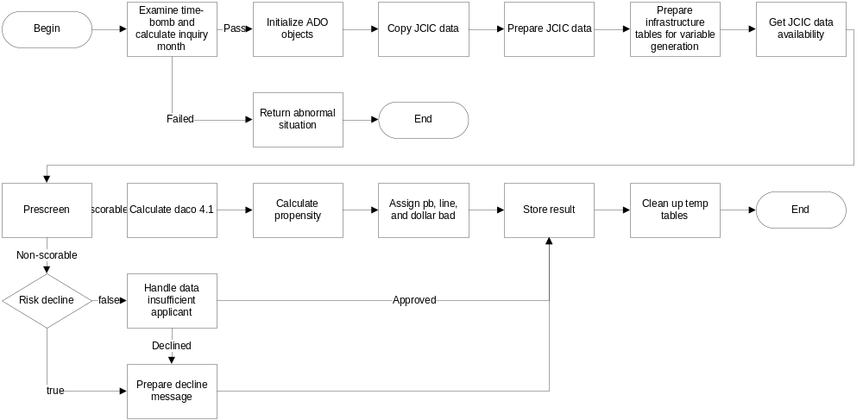
PROGRAM FLOW OVERVIEW
Notes:
Size: H 4.01” W 9.00”
Position: V 0.33” H 1.92”

Slide 29
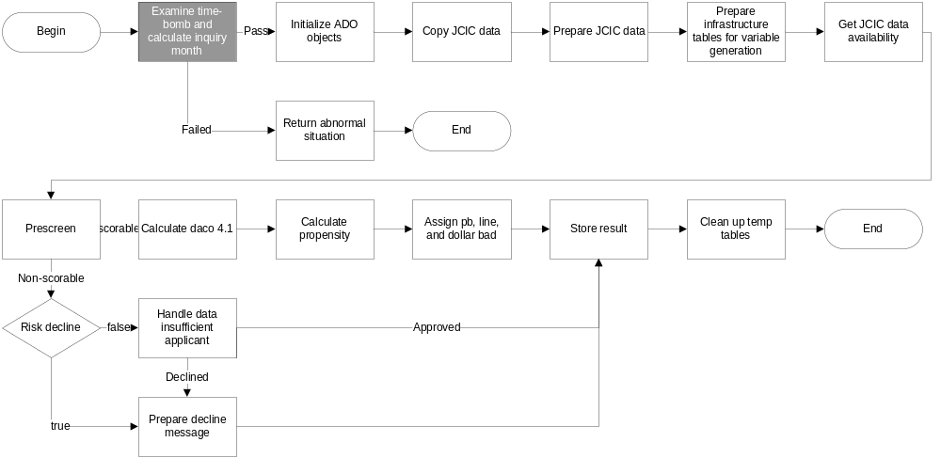
EXAMINE TIME-BOMB AND CALCULATE INQUIRY MONTH
Notes:
Size: H 4.01” W 9.00”
Position: V 0.33” H 1.92”

Slide 30
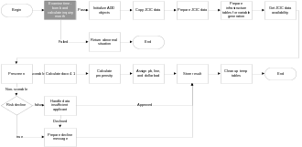
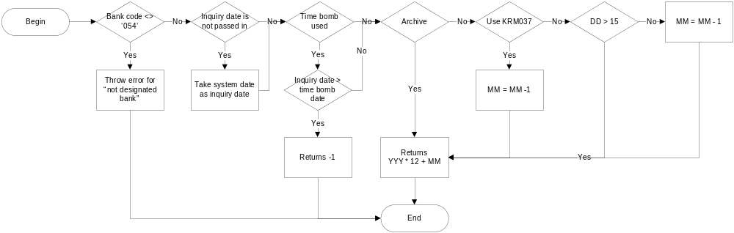
EXAMINE TIME-BOMB AND CALCULATE INQUIRY MONTH

Slide 31
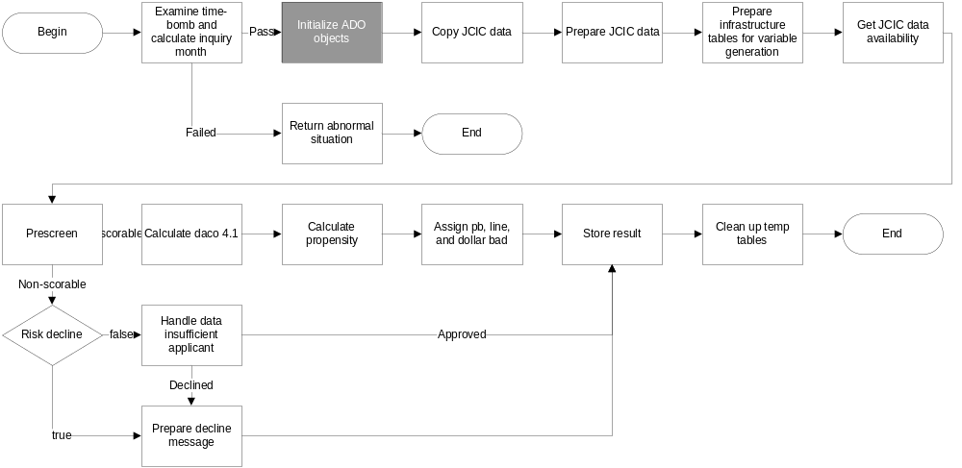
INITIALIZE ADO OBJECTS

Slide 32
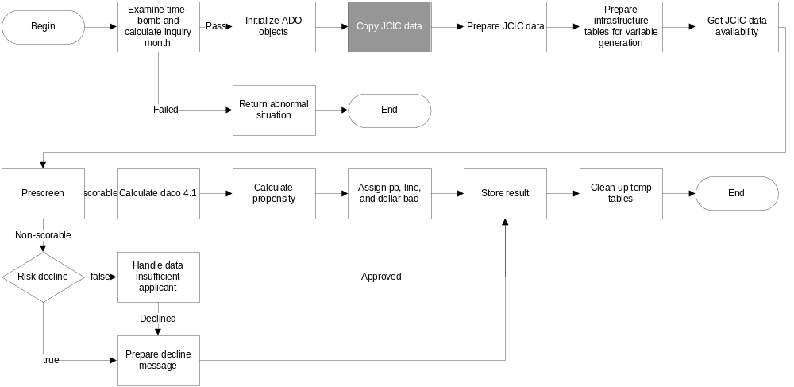
COPY JCIC DATA

Slide 33
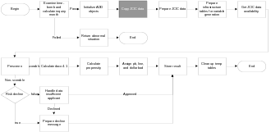
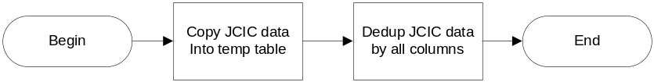
COPY JCIC DATA
JCIC data includes:
BAM086
JAS002
KRM021
KRM023
KRM037
STM007
VAM102

Slide 34
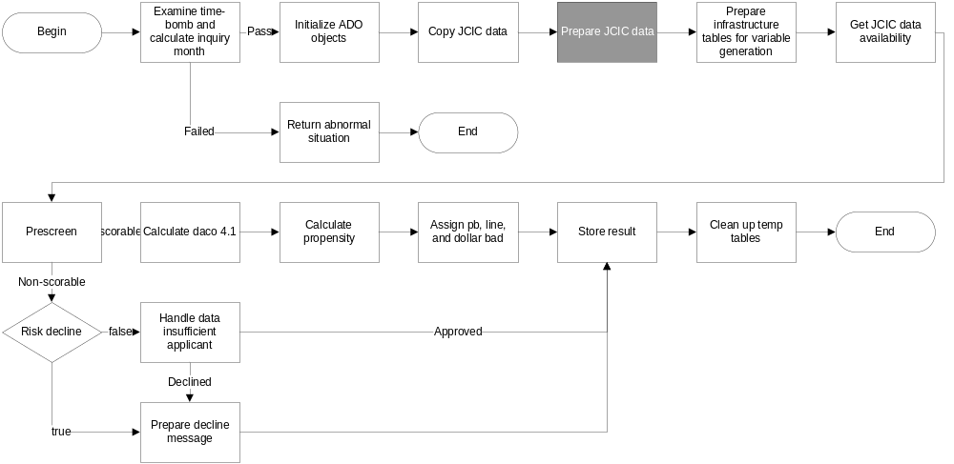
PREPARE JCIC DATA

Slide 35

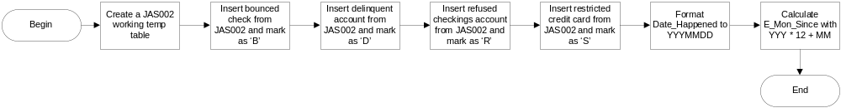
PREPARE JCIC DATA
JAS002
KRM021
STM007

Slide 36
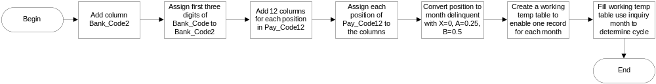
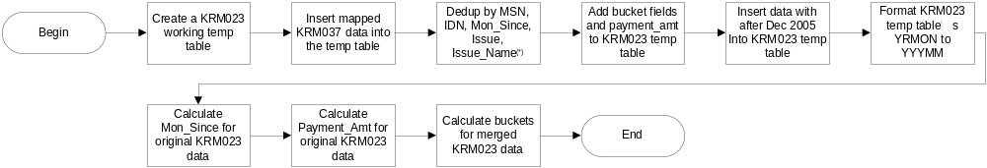
PREPARE JCIC DATA
BAM086
KRM023 / KRM037
(*) The monetary data Items (Limit, Spread_Payment, Payment_Amt) are all summed up If case of duplication.
Should any of the record among the duplicated has cash advance, the de-dupped record Is marked as using cash advance.

Slide 37
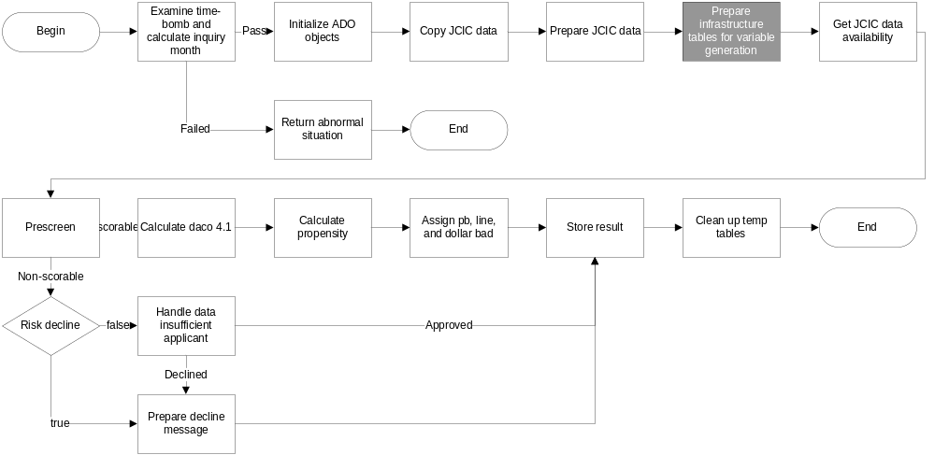
PREPARE VARIABLES GENERATION INFRASTRUCTURE

Slide 38
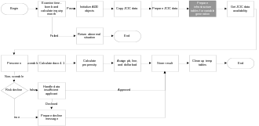
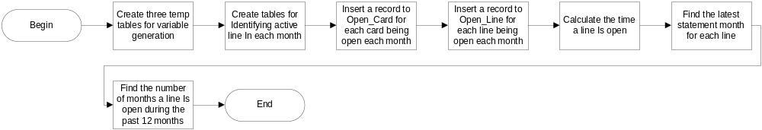
PREPARE VARIABLES GENERATION INFRASTRUCTURE
(*) The monetary data Items (Limit, Spread_Payment, Payment_Amt) are all summed up If case of duplication.
Should any of the record among the duplicated has cash advance, the de-dupped record Is marked as using cash advance.

Slide 39
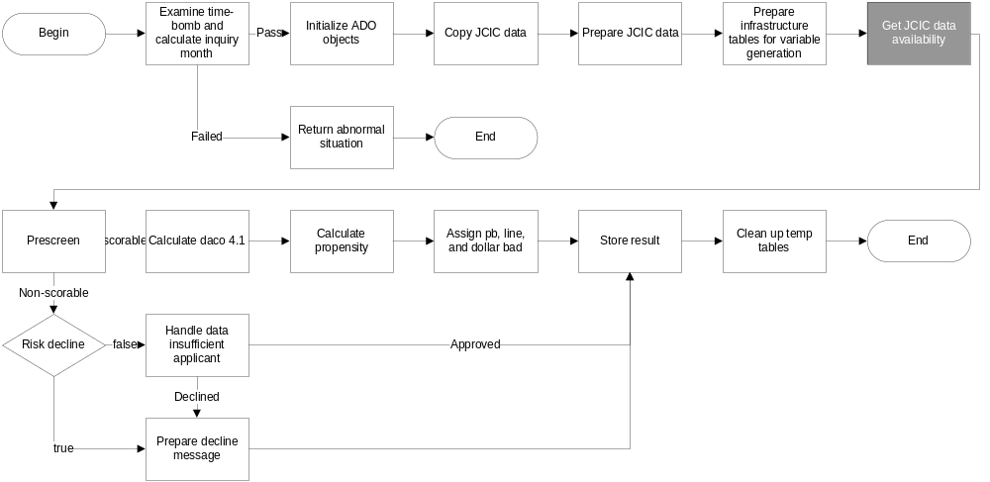
GET JCIC DATA AVAILABILITY

Slide 40
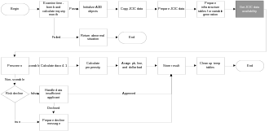
GET JCIC DATA AVAILABILITY
JCIC data availability flag
0x00 : No JCIC data
0x01 : KRM023 / KRM037 hit
0x02 : KRM021 hit
0x04 : BAM086 hit
0x08 : STM007 hit
0x10 : JAS002 hit

Slide 41
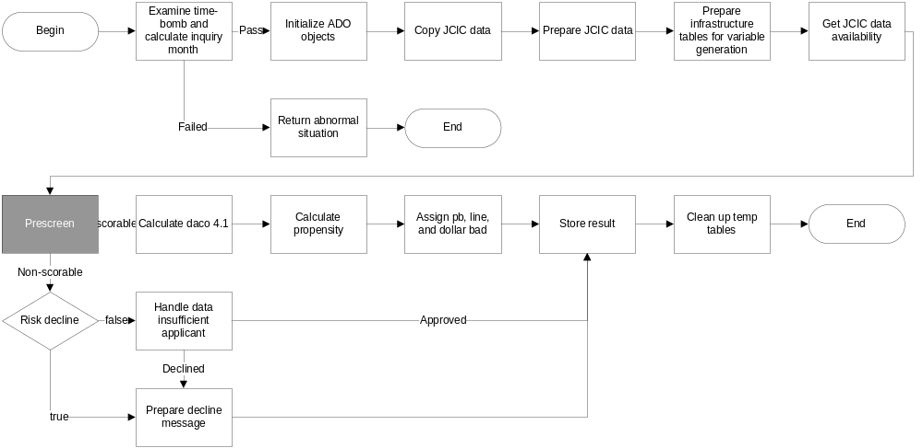
PRESCREEN

Slide 42
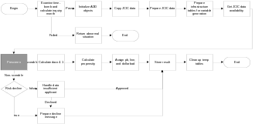
PRESCREEN
Prescreen exclusion flag
0x0000 : Pass prescreen
0x0001 : No KRM023 / KRM037
0x0002 : No KRM021
0x0004 : Earliest KRM023 month less than 6 months ago
first KRM021 card open less than 7 months
0x0008 : KRM023 max bucket > 3 (ef, 1K)

Slide 43
PRESCREEN
Prescreen exclusion flag (CONT.)
0x0010 : BAM086 Pass_Due_Amt > 0
0x0020 : JAS002 major derag
0x0040 : BAM086 cash card delinquent in latest month
0x0080 : BAM086 cash card utilization >= 95%
0x0100 : BAM086 max bucket > 1
0x0200 : KRM023 total utilization > 75%
0x0400 : Unsecured revolving balance(*) >= NT$500K
0x0800 : Total lines no more than 2 and has at least one delinquent line
0x1000 : Insufficient JCIC data with more than 2 recent inquirues
0x2000 : Insufficient JCIC data
(*) : Unsecured revolving balance = KM023 revolving balance in most recent month +
KRM037 spread_payment from revolver or cash advance user + BAM086 cash card balance

Slide 44
PRESCREEN
MAPPING PRESCREEN CODE TO EXCEPTION CODE
Prescreen exclusion flag | Exception code
0x0008 | 102
0x0010 | 105
0x0020 | 101
0x0040 | 103
0x0080 | 104
0x0100 | 107
0x0200 | 203
0x0400 | 108
0x0800 | 204
0x1000 | 109
0x2000 | 201

Slide 45
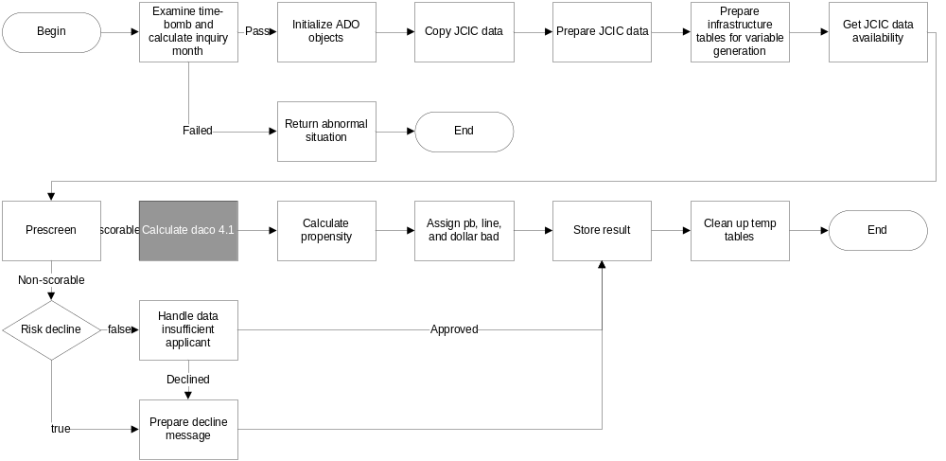
CALCULATE DACO 4.1

Slide 46
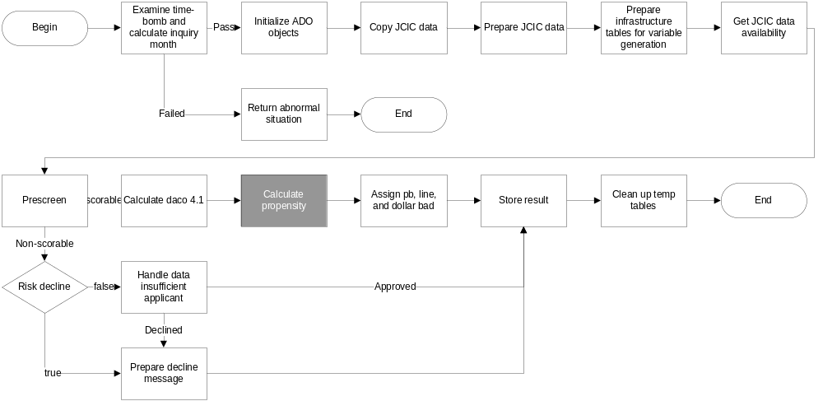
CALCULATE PROPENSITY

Slide 47
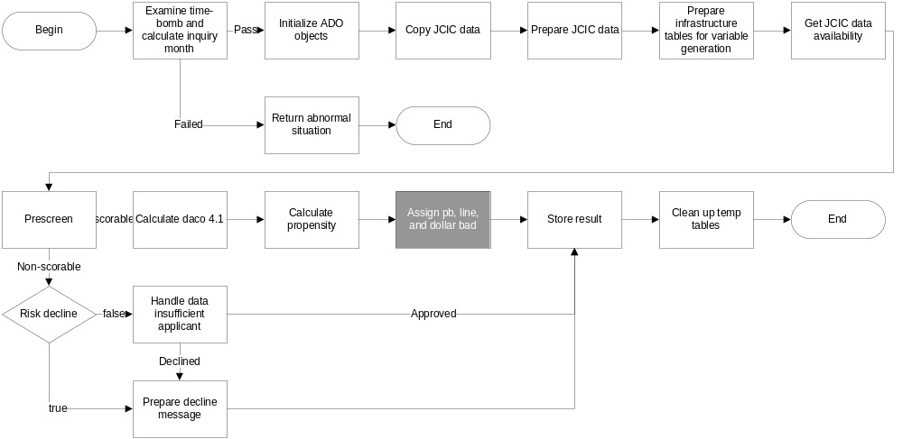
ASSIGN PB, LINE, AND DOLLAR BAD

Slide 48

ASSIGN PB, LINE, AND DOLLAR BAD
R = DACO 4.1 twentile; P = propensity twentile

Slide 49
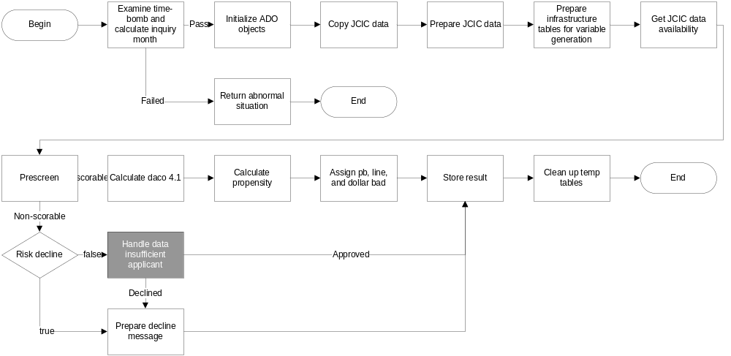
HANDLE DATA INSUFFICIENT APPLCIANT

Slide 50
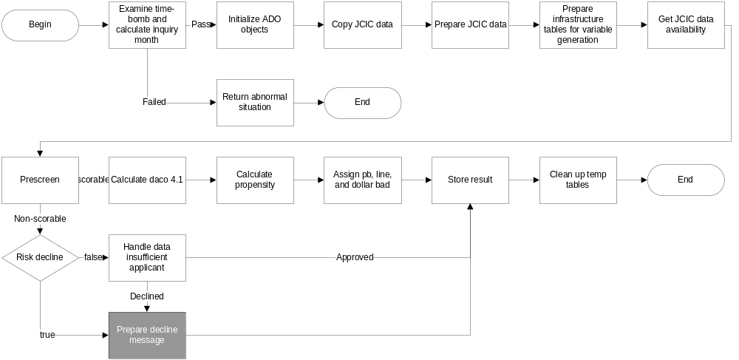
PREPARE DECLINE MESSAGE

Slide 51
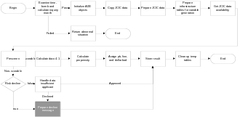
DECLINE MESSAGE
Exception code | Decline message
0 | The approval module has expired.
1 | 本DAC核准模組僅供京城銀行使用。
101 | 模組建議婉拒，曾經強停 / 拒往 / 退票 / 授信異常。
102 | 模組建議婉拒，任一信用卡連續三個月以上循環繳款不正常。
103 | 模組建議婉拒，任一現金卡最近一個月繳款延遲。
104 | 模組建議婉拒，任一現金卡動用比率 >= 95%。
105 | 模組建議婉拒，任一貸款逾期。
107 | 模組建議婉拒，任一貸款連續三個月以上循環繳款不正常。
108 | 模組建議婉拒，信用卡與現金卡餘額過高。
109 | 模組建議婉拒，JCIC資料不足且查詢次數過多。
200 | 模組建議人工審核，JCIC資料不足。
201 | 模組建議人工審核，JCIC資料不足。建議核准額度不宜超過新台幣兩萬元。
203 | 模組建議人工審核，信用卡循環金額 > 額度的75%。
204 | 模組建議人工審核，信用卡額度數 <= 2且半數以上信用卡曾經延遲繳款。

Slide 52
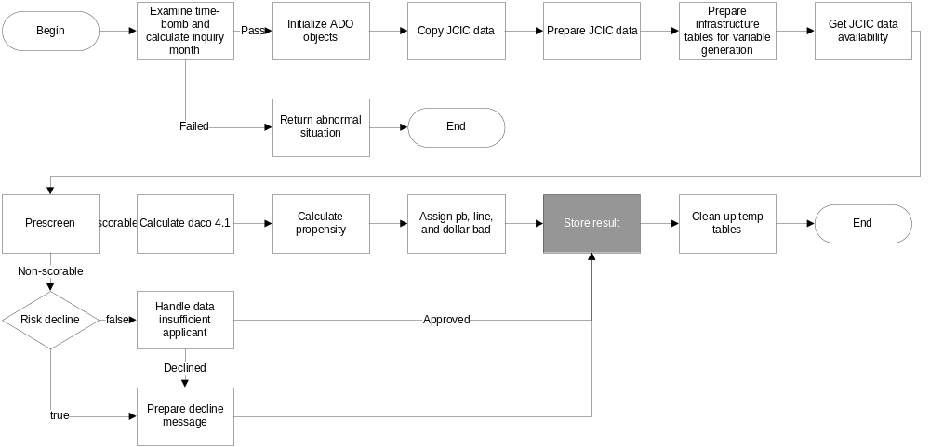
STORE RESULT

Slide 53
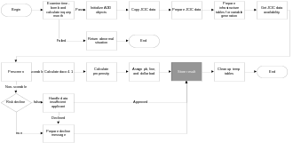
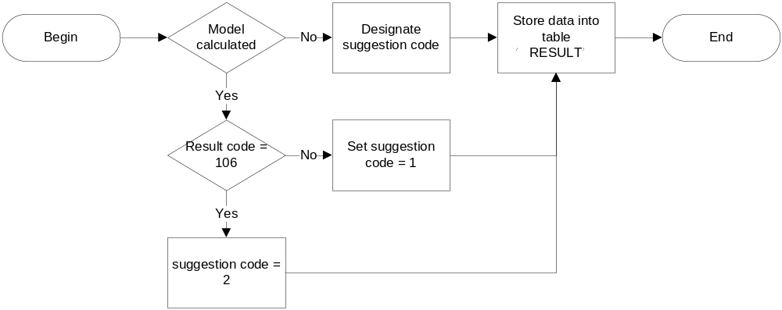
STORE RESULT

Slide 54
STORE RESULT – DESIGNATE SUGGESTION CODE
The following exception codes has suggestion code -1 (abnormal)
  0 − 1
The following exception codes has suggestion code 2 (decline)
  101 − 102 − 103
  104 − 105 − 107
  108 − 109
The following exception code has suggestion code 3 (manual review)
  201 − 202 − 203
  204

Slide 55
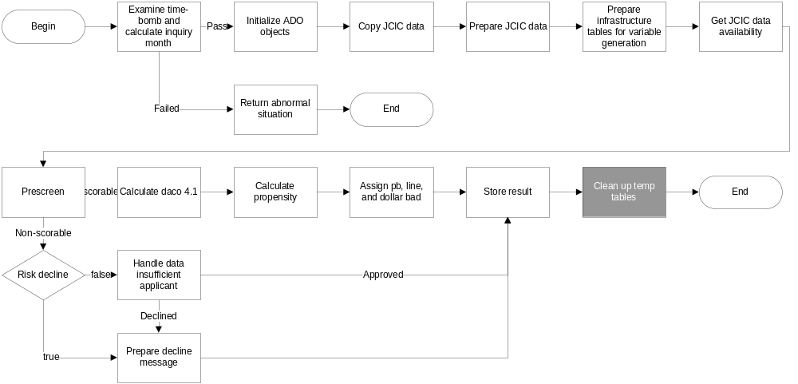
CLEAN UP TEMP TABLES

Slide 56
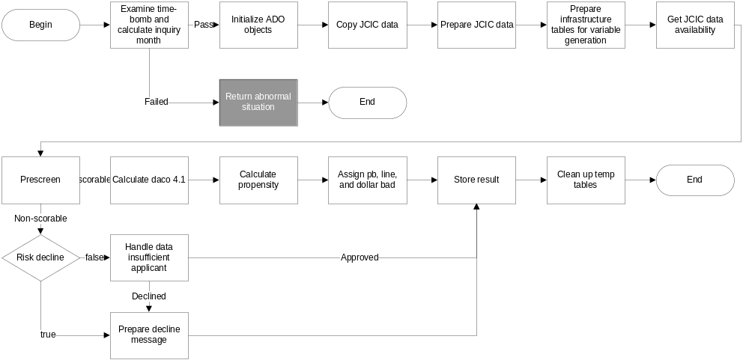
RETURN ABNORMAL SITUATION

Slide 57
CONTENTS
Technical highlights
Input and output environment
Application Programming Interface
Program flow
Program files

Slide 58
PROGRAM FILES
File name | Description
cc_am.cpp | Risk model (DACO 4.1) Propensity model Line and PB mapping tables Approval module logics
cc_am.h | Definition of JCIC working temp tables Functions declaration for cc_am.cpp
cc_err.cpp | Exception codes and suggestion messages
cc_err.h | Functions declaration for cc_err.cpp

